Slide 1
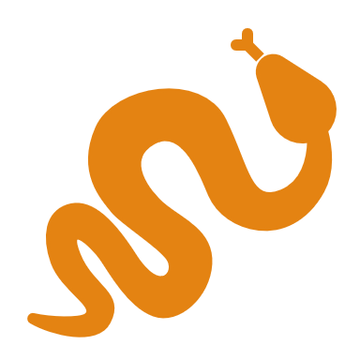
NumPy Practice
OPTIMIZATION LAB
2021-12-03

Slide 2
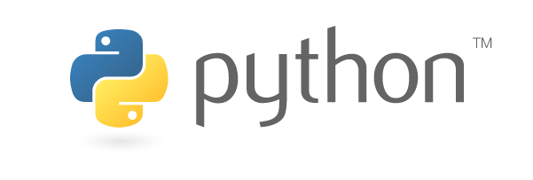

Content
NumPy Arrays review.
Time library.
Introduction to PyPlot.

Slide 3
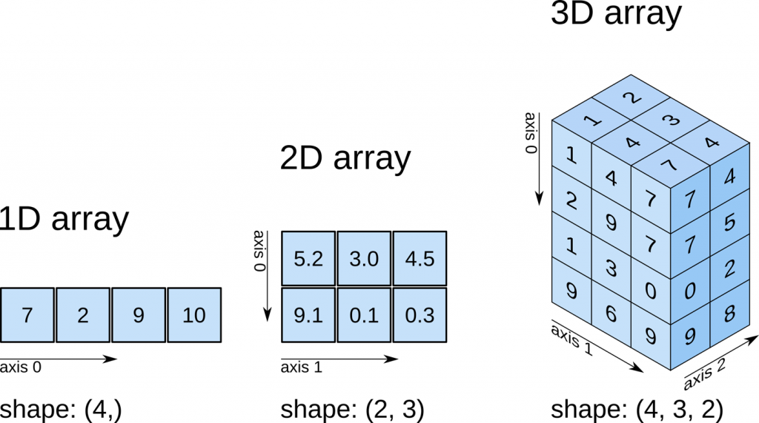
N-dimensional arrays indexing

Slide 4
Matplotlib
Library to create visualizations.
PyPlot submodule:
High-level utilities to plot

